Slide 1



2018
ISSCC
3rd Tdm meeting
Moscow, 18th October 2018
International Smart Sustainable City Club

Slide 2
Approval of Meeting Agenda
Time | Content
13:30 – 13:35 | Approval of meeting agenda
13:35 – 13:40 | Roll call of participants
13:40 – 13:45 | Speech by Chairman
13:45 – 13:50 | Review on resolutions of past meetings
13:50 – 14:20 | Introduction of ISO/TC268 standards ISO 37101 / ISO 37104 by Etienne Cailleau (10 min) ISO 37106 by Chris Parker (10 min) ISO 3715X on Smart Transportation by Hiro Sakai (10 min)
14:20 – 15:00 | ISSCC Matters (see right)
15:00 – 17:00 | Exchanges & presentations by member cities
17:00 – 17:30 | Summary & Closing Remarks
14:20 – 15:00 | ISSCC Matters
 | ISO TC 268 context Progress review Secretariat assignment Procedure to become P member, S member Procedure to become DEMO City Nomination of duty chair city Nomination of council members candidates ISSCC Website Time and place for 2019 congress Any Other Business

Slide 3
Resolutions of past TDMs

Slide 4
Resolution of
TDM 1st Preparation Meeting Beijing, Jan. 2018
Acceptance procedure for new member entering with experimentation, information collection and feedback.
three points included:
  Small and medium-sized cities topic 中小城市议题
  Provide infrastructure and services for the senior citizen 为老年人提供基础设施和服务
  the Beijing – Hangzhou Grand Canal concept 京杭大运河设想
Dr. Bernard GINDROZ is the Chairman, and Ms. SHAO Xinhua was authorized as the first Secretary General of ISSCC with a term of 5 years.
Held the 2nd club conference in 2018, time and place to be decided.

Slide 5
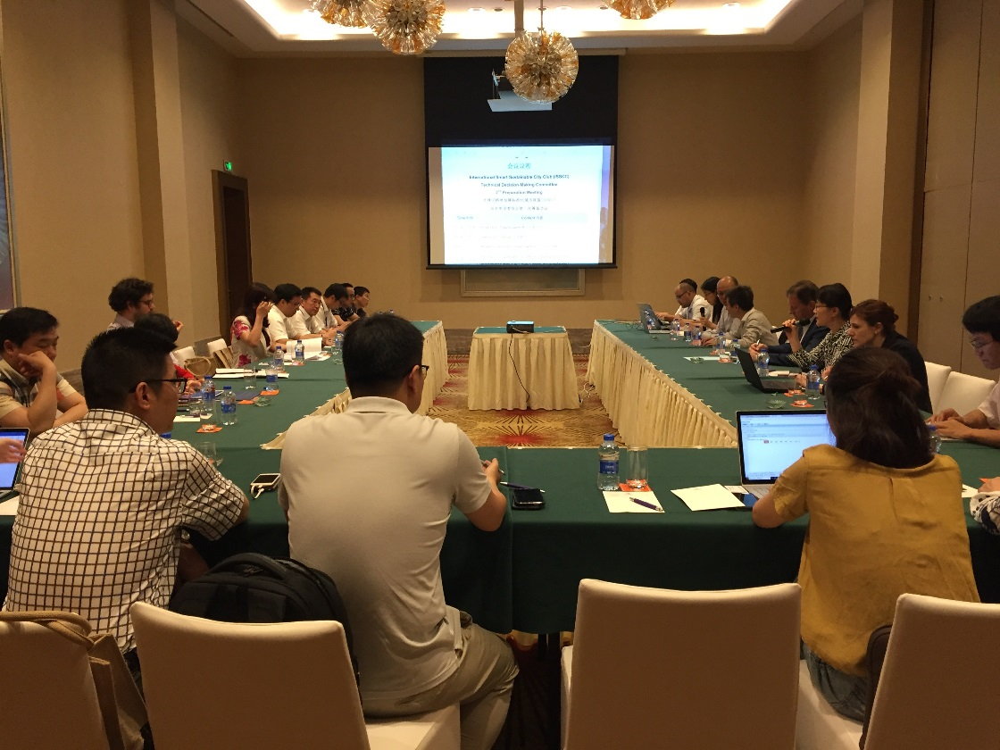
Resolution of
TDM 2nd Preparation Meeting Zhuhai, May 2018
Procedure approved on Experimentation stage, Demonstration Stage, and Pilot Stage for cities.
Application Acceptance letters issued to BFSP, Hangzhou CBD and Xiaoyi City to become experimentation city on ISO 37101.
Next meeting agreed in Moscow, October 15-19，2018.

Slide 6
05
Introduction of iso tc 268 standards
PART FIVE

Slide 7
06
ISSCC Matters
PART SIX

Slide 8
ISSCC Matters
ISO TC 268 context
Registration progress review
Secretariat assignment
Procedure to become P member, S member
Procedure to become a DEMO City
Nomination of duty chair city with Executive chairman
Nomination of council members candidates
ISSCC Website
Time and place for 2019 congress
Any Other Business

Slide 9
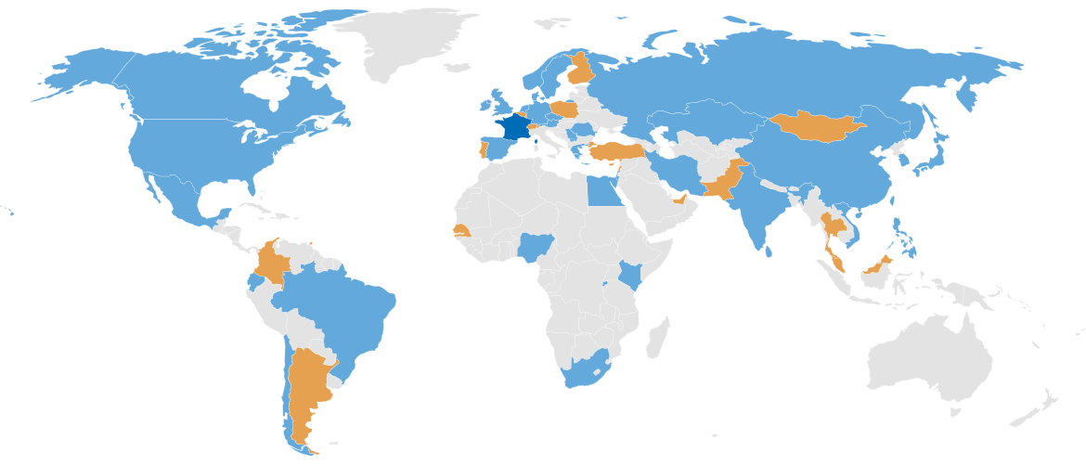
ISSCC Context
ISO TC 268 Sustainable cities and communities
The proposed series of International Standards will encourage the development and implementation of holistic and integrated approaches to sustainable development & sustainability.
Participating countries: 37
Observing countries: 21
Secretariat: AFNOR, Mr. Etienne Cailleau
Chairman: Dr. Bernard Gindroz
Creation date: 2012

Slide 10
ISSCC Context
A need to get feedbacks from practical implementation
→ International Smart Sustainable City CLUB (ISSCC)
Political Commitment
Implementation/demo/pilot
Vision
1. DECISION/
COMMIT
(Strategy)
2. PLAN
(roadmap & targets)
3. DO
Implementation)
4. CHECK
(against targets)
5. ACT
(Correct)
Management throughout the whole process

Slide 11
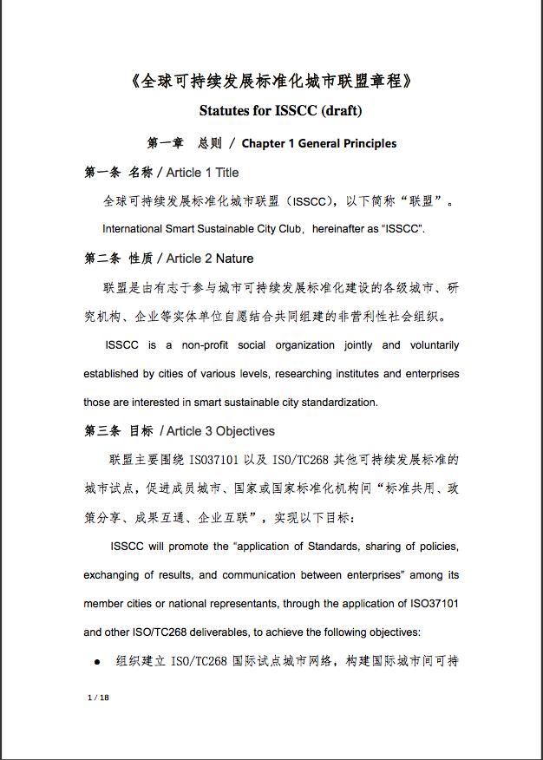
ISSCC CONTEXT
ISSCC is a non-profit organization jointly and voluntarily established by cities of various levels, researching institutes, enterprises and NGOs interested in smart sustainable city standardization.
The ISSCC Statutes include the objectives, main tasks, organizational structure, access procedures and operation mode.
Statutes for ISSCC (draft)
《全球可持续发展标准化城市联盟章程》

Slide 12

ISSCC Main tasks
ISSCC will actively involve worldwide cities of various levels and national representatives, with the main tasks as below:
Hosting congress and seminars, establishing liaisons among mayors;
Constructing a communication platform;
Helping members to become international smart sustainable pilots of ISO 37101 and then ISO 371XX series;
Support cities for auto-evaluation of progresses;
During the implementation of ISO/TC268 standards (especially ISO37101), provide support and guidance through different stages:

Slide 13
ISSCC Objectives
ISSCC will promote the principle of “applying standards, sharing policies, exchanging results, and communication between enterprises” among its members, through the application of ISO37101 and other ISO/TC268 deliverables, to achieve the following objectives:
Organize a Global City Network piloting ISO/TC268 standards, build an exchanging platform for cities on sustainable development, and improve sustainability and efficiency of governance for member cities.
Actively participate ISSCC events in conjunction with ISO/TC 268 meetings, collect feedbacks and suggestions on urban sustainable development, and offer recommendations for ISO TC 268 standards.
Promote international cooperation among member cities, through standard implementation, exchanging and communication. Also contribute to economic collaborations between cities.
1
2
3

Slide 14
ISSCC Organizational chart
Permanent
Chair City
Chairperson
of ISSCC
Executive Chairperson
Duty Chair City
Congress of ISSCC
Council of ISSCC
President of ISO/TC268;
Rep. of SAC;
Rep. of AFNOR;
Rep. of add. NSB;
Rep. of Permanent Chair City;
Rep. of council
Technical Decision-Making committee
Guide
Secretariat
(Organised by Secretariat of ISO/TC268)
Supervise
liaise
Think Tank
NSB of member cities
Guide & Support
P Member cities
S Members
Expert Committee
Advisory Institutes
Support and Quality Control

Slide 15
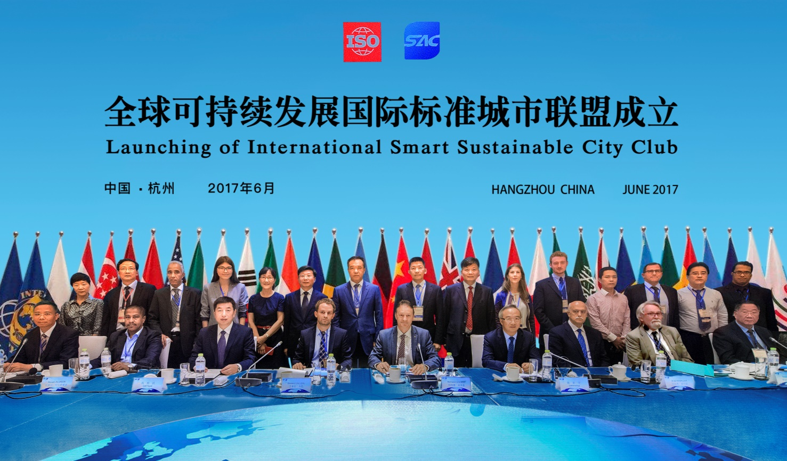
Progress Review
Action plan for procedures
Finalise the creation of ISSCC

Slide 16
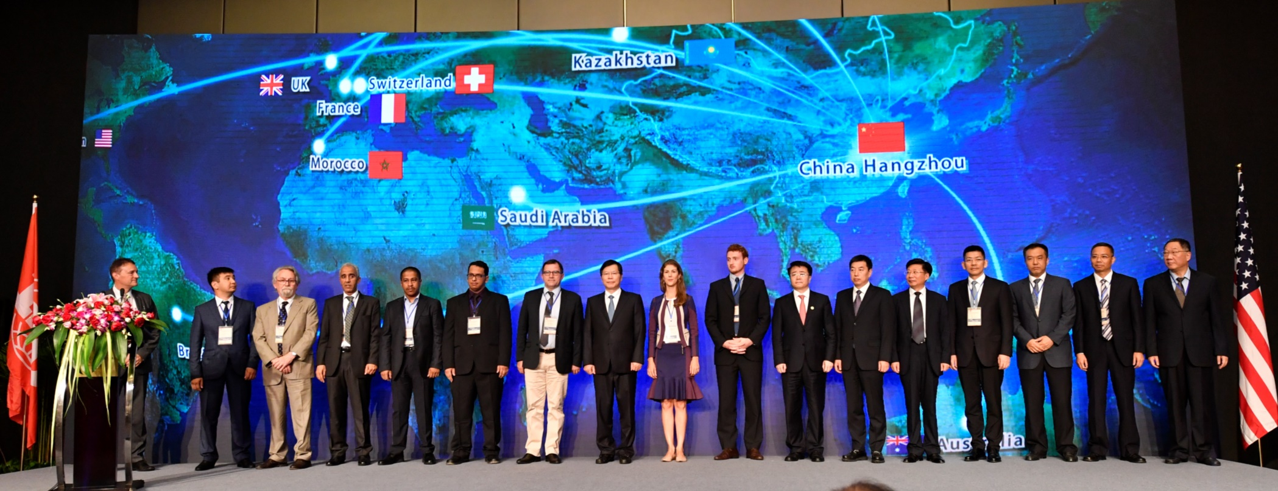
ISSCC officially launched on June 30th, 2017
16 cities globally participated, with support of ISO, IEC, ITU-T, UN, World Bank.
Rennes, France;
Versailles Grand Parc, Paris Region, France;
Grasmere, United Kingdom;
Astana, Kazakhstan;
Londrina, Brazil;
Riyadh, Saudi Arabia;
Abu Dhabi, United Arab Emirates;
Rabat, Morocco;
China:
Hangzhou; Guangzhou; Shenzhen; Qingdao;
Chengdu; Dalian; Changchun; Xianning

Slide 17

New members 2018
Krasnodar
CSEC Tianjin
Novorossiysk
Beijing FSP
Sochi
ISSCC
Hangzhou CBD
Togliatti
Xiaoyi
Voronezh
Innopolis
Sarov
Magas

Slide 18
Secretariat Assignment
Mirror Committee or NSB from duty chair city to allocate a specific secretary; to support the council；
Etienne Calliaeu to support the coordination with ISO TC 268 and documents circulation within ISSCC
Xinhua Shao as the Secretary General

Slide 19

Procedure to become a P member
Membership fee waived for 3 years.
Form to be filled and signed and submitted online;
Secretariat office to circulate;
Approved by simple majority of Council Members;
Chairman signed and membership rectified;
Experimentation letter issued;
International Experimentation City plate issued;

Slide 20
Procedure to become an S member
(S)upporting members will be organisations, research institutes and enterprises locate within areas of official P members; as well as international organisations.
S members can make propositions to the Council, whilst having no voting rights. Membership required.
Form to be filled and signed;
Return to the secretariat office;
Approved by 1/3 Council Members;
Chairman signed and membership rectified;
Recognition Letter issued;

Slide 21

Procedure to become a DEMO
In order to encourage active participation in ISO TC 268 activity, the successful admission of International Demo city of ISO 37101, recognized by ISSCC, will require:
3 No. of presentations to ISO/TC 268 WG1, regarding the progress of application of ISO 37101;
Recognition from NSB;
1 on-site review session, to include at least 3 country experts from ISO TC 268;
1 report of the ISO 37101 experiment according to the ISSCC released template;
Written contribution on feedback of ISO TC 268 standards and expression of needs/improvement. (can be included in the report)

Slide 22
Proposed Template for DEMO
 | Initial Status | Implementation Scheme | Improvements
Vision / Purpose
Objectives
Issue with Strategy
Leadership
PDCA-Planning
PDCA-Operating
PDCA-Evaluation
PDCA-Support
Feedback on 37101 and to TC 268
Appendix
1 ISSCC participation activities
2 ISO TC 268 participation activities
3 Profile and self-introduction

Slide 23
Nomination of duty chair city with Executive chairperson
The Congress of ISSCC will nominate a duty chair city every two years, The elected duty chair city shall appoint its mayor or deputy mayor as the executive chairperson, who will stay available for one additional year to support the new executive chairperson.
Executive Chairperson to participate TDM meetings and tele-conference;
Participation of every ISSCC activities during the term;
Hosting at least one ISSCC congress within 2 years;
Responsible for producing an ISSCC leaflet with the support from the secretariat during the term;
Produce & maintain a local language version of ISSCC website;

Slide 24
Nomination of council members
Agree and abide the regulations of ISSCC
Member city/community or National Standardization Bodies for member city countries.
Comply with guidance of Technical Decision-Making(TDM) Committee
Get involved in the implementation of sustainable city/community development standard, and to carry out experimentation on sustainable city/community development
Be nominated jointly by the Chairperson and Secretariat of ISSCC, and confirmed through ISSCC member cities
Nomination during 18th October ~ 18th November, 2018, and communicate commitment to the ISSCC chairperson.

Slide 25
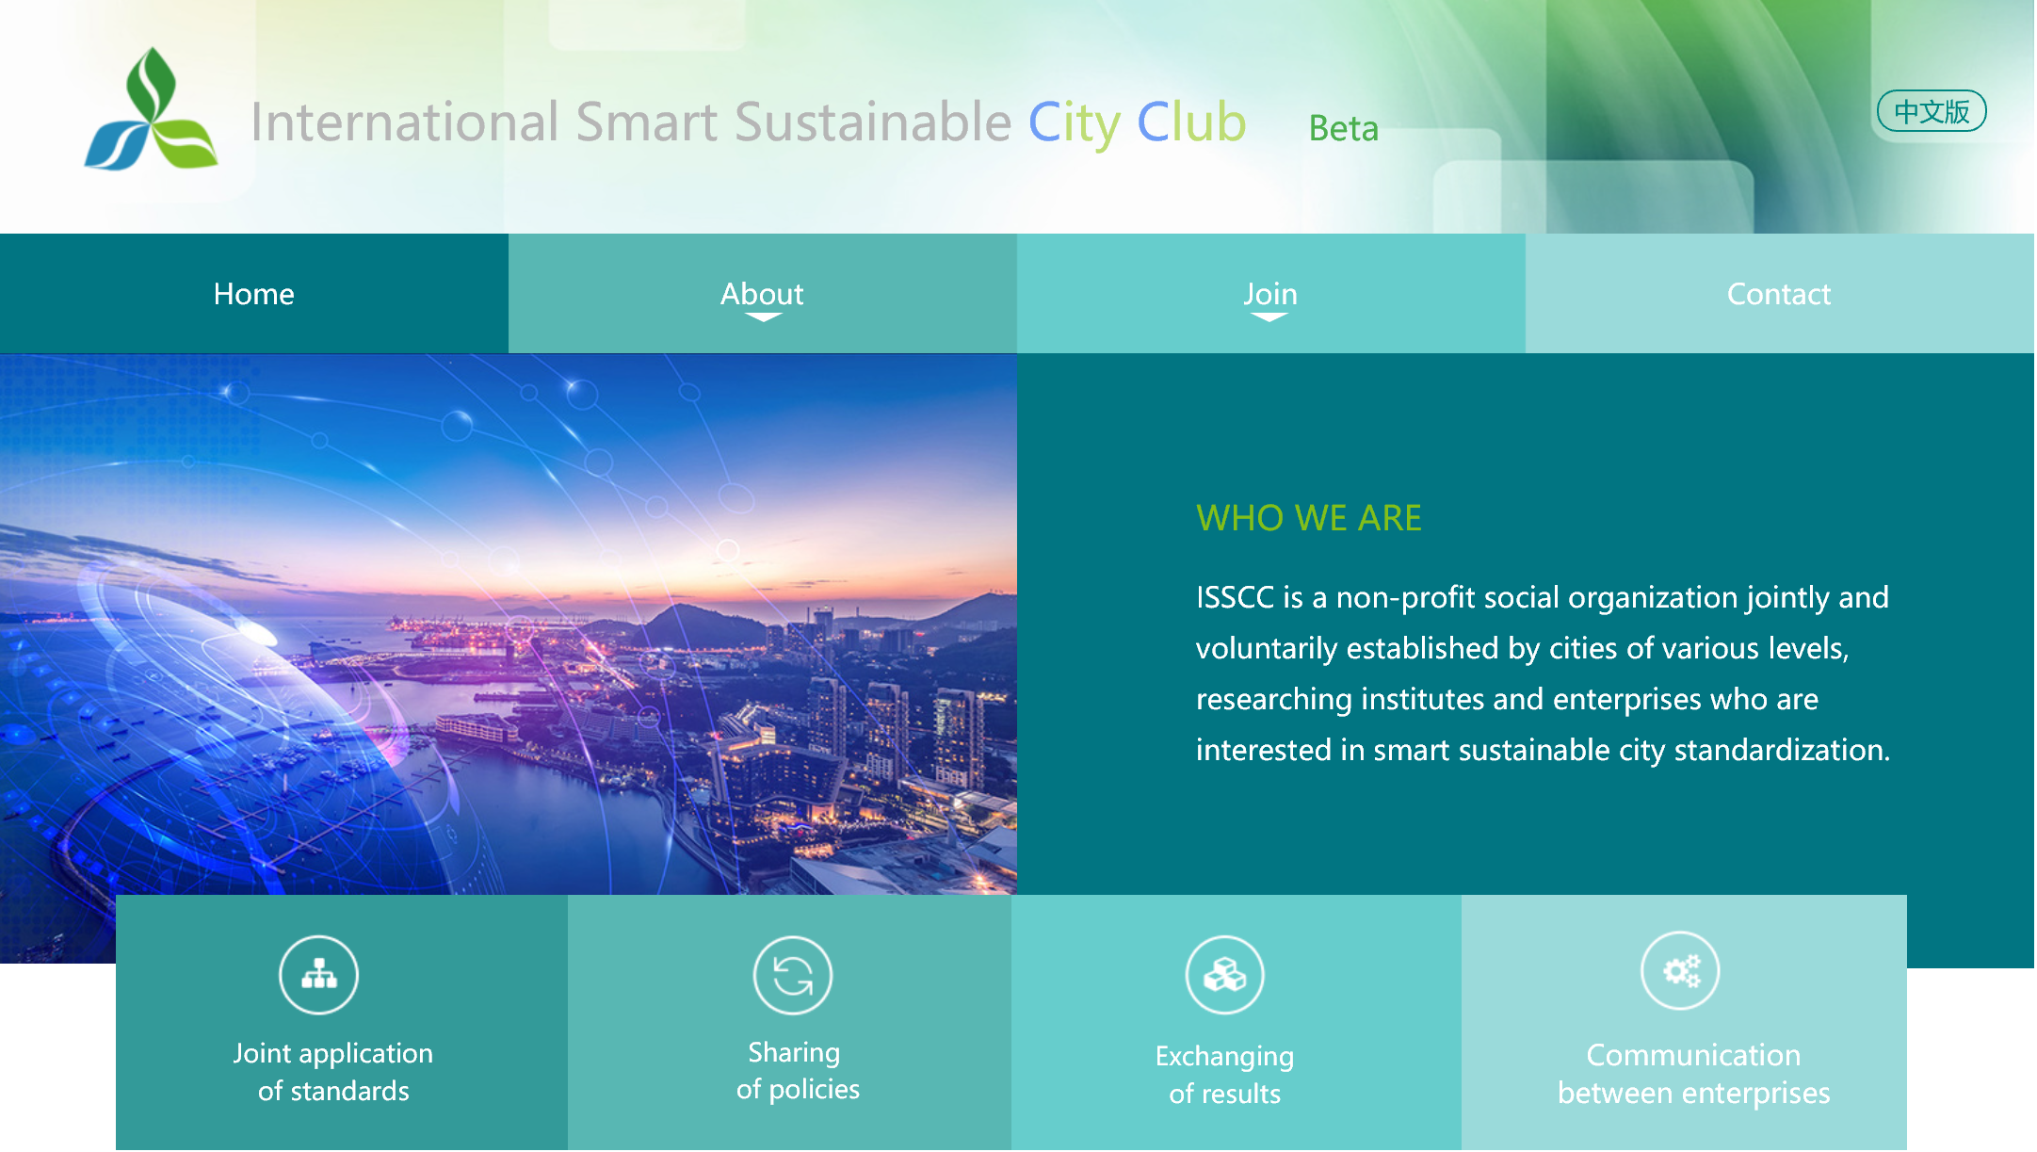
ISSCC Website
Registered www.issCityClub.org
beta version online from October 2018
Collect feedback for 2 months
Up and running from January 2019
Comments please send to the secretariat

Slide 26
Time and place for 2019 congress
Recommendation
Paris, France, April 8th~ 12th 2019 with ISO TC 268 plenary
Sweden/Japan/Cyprus October 14th ~18th 2019 (option)

Slide 27
Any Other Business?

Slide 28
07
CITIES EXCHANGE
PART SEVEN

Slide 29
New members 2018
Krasnodar
Innopolis
Novorossiysk
CSEC Tianjin
ISSCC
Sarov
Sochi
Beijing FSP
Magas
Togliatti
Voronezh

Slide 30
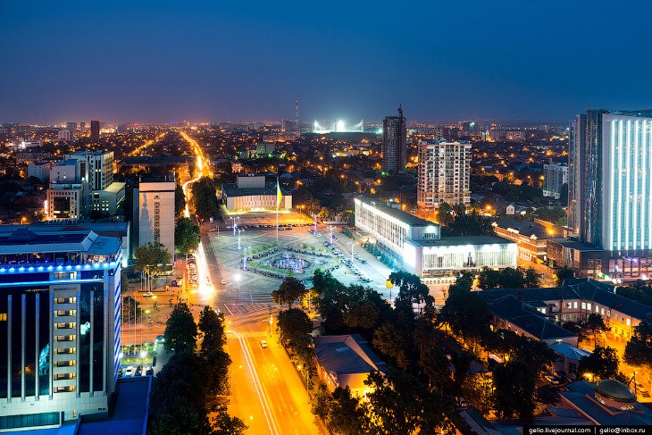

Krasnodar
Moscow
Krasnodar
The administrative center of Krasnodar Krai, Russia
Krasnodar is the economic center of southern Russia
For several years, Forbes magazine named Krasnodar the best city for business in Russia
1,000,000 population
Area 339 sq. km

Slide 31
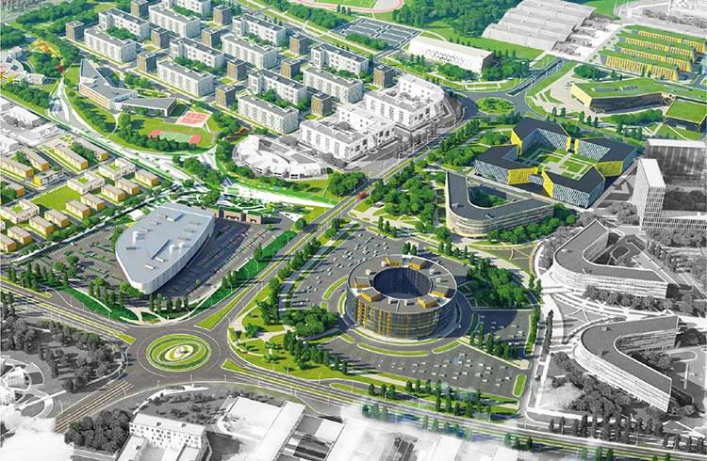
Innopolis
Moscow
Innopolis
Innopolis is a town in Verkhneuslonsky District of the Republic of Tatarstan, Russia
Innopolis was established on December 24, 2012 as a technology park
Innopolis has created a Special economic zone to attract promising technology companies
102 population
Area 2,2 sq. km

Slide 32
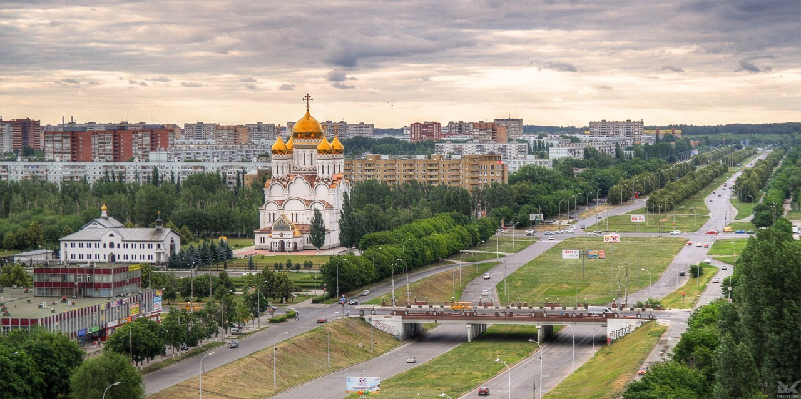

Togliatti
Moscow
Togliatti
Togliatti is a city in Samara Oblast, Russia
Togliatti is best known as the home of Russia's largest car manufacturer AvtoVAZ (Lada), which was founded in the late 1960s
710,567 population
Area 314 sq. km

Slide 33
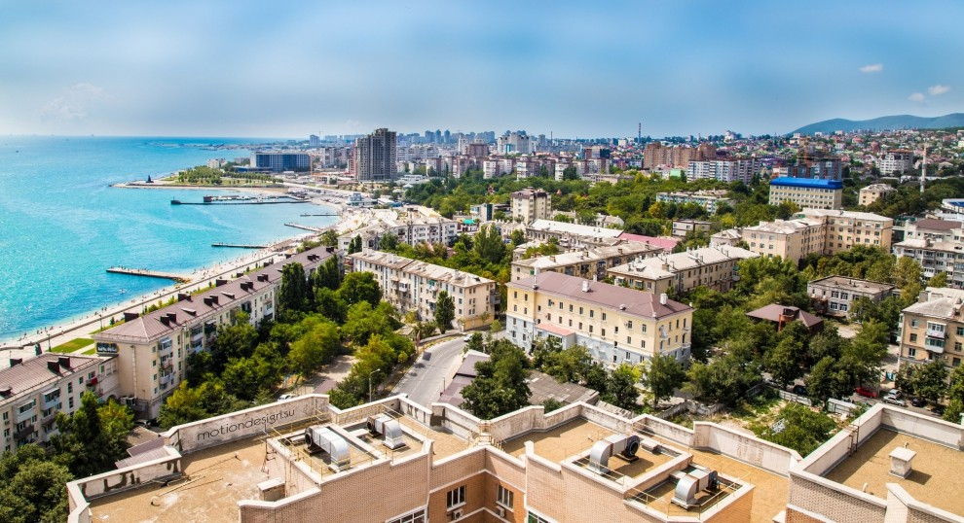

Novorossiysk
Moscow
Novorossiysk
Novorossiysk is a city in Krasnodar Krai, Russia
It is the country's main port on the Black Sea, the leading Russian port for exporting grain, the center of the cement industry
273,278 population
Area 81 sq. km

Slide 34
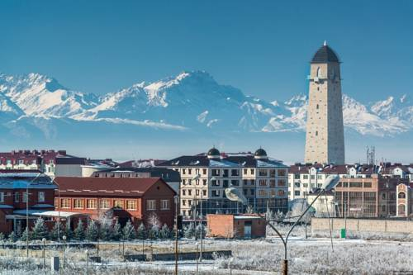

Magas
Moscow
Magas
Magas is the capital town of the Republic of Ingushetia, Russia
Magas is the youngest and smallest capital of a federal subject in Russia, founded in 1994
8,771 population
Area 12,6 sq. km

Slide 35
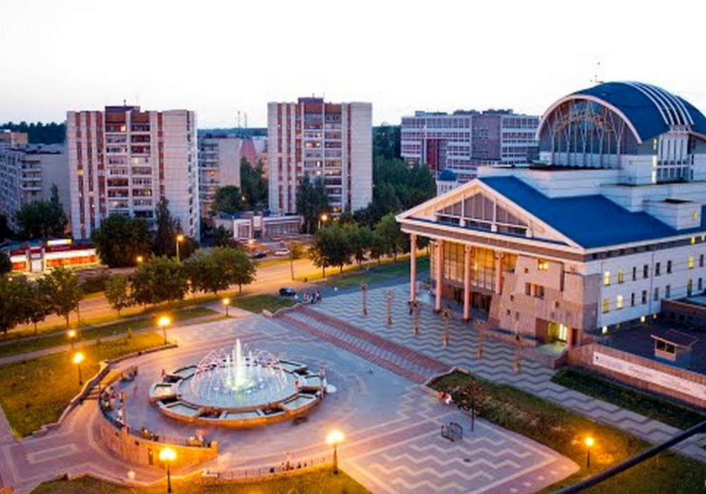

Sarov
Moscow
Sarov
Sarov is a closed city in Russia, located on the territory of the Nizhny Novgorod region and the Republic of Mordovia
The city-forming enterprise of Sarov is Russian Federal Nuclear Center - Russian Research Institute of Experimental Physics
95,065 population
Area 232 sq. km

Slide 36
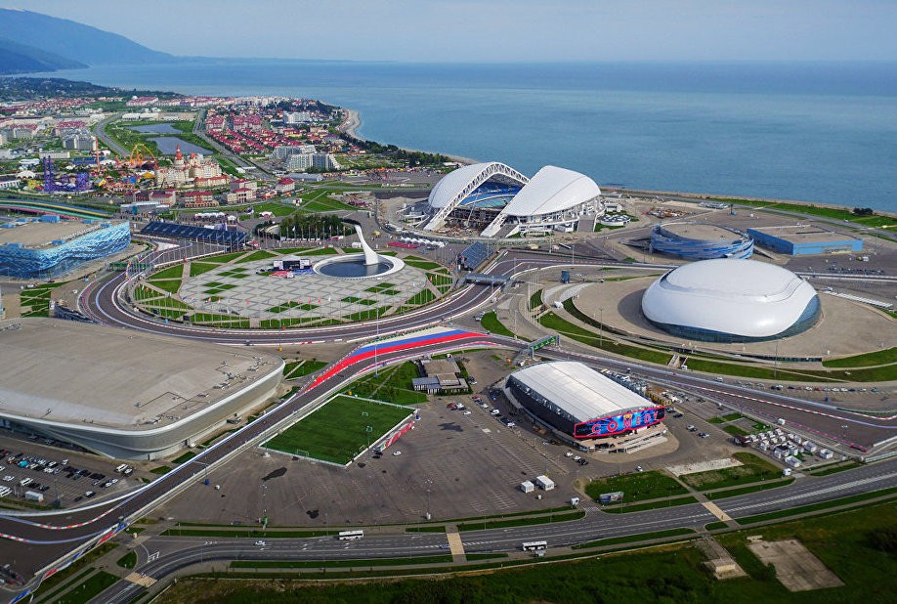

Sochi
Moscow
Sochi
Sochi is a city in Krasnodar Krai, Russia
Sochi is the largest resort city in Russia
Sochi hosted the XXII Olympic Winter Games in 2014, Russian Formula 1 Grand Prix from 2014, was one of the host cities for the 2018 FIFA World Cup
424,281 population
Area 177 sq. km

Slide 37
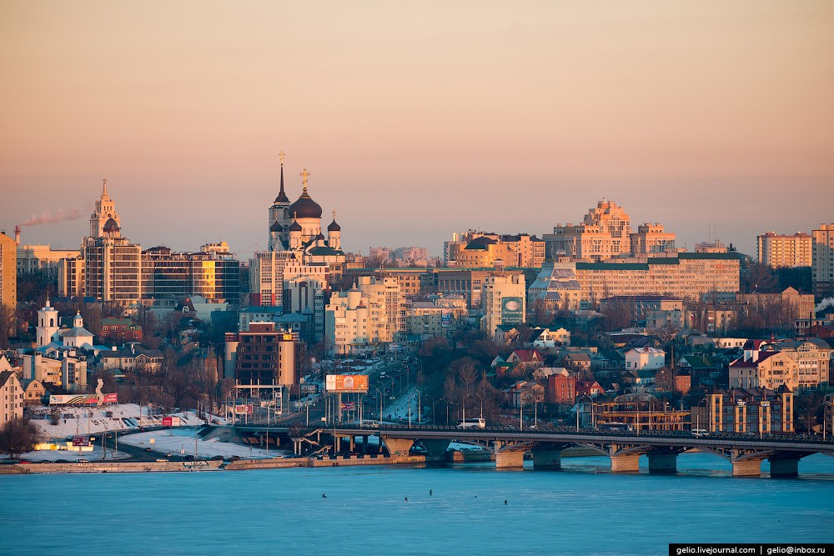

Voronezh
Moscow
Voronezh
Voronezh is a city and the administrative center of Voronezh Oblast, Russia
Voronezh is considered to be the birthplace of the Russian state navy and of airborne troops
1,058,547 population
Area 600 sq. km

Slide 38

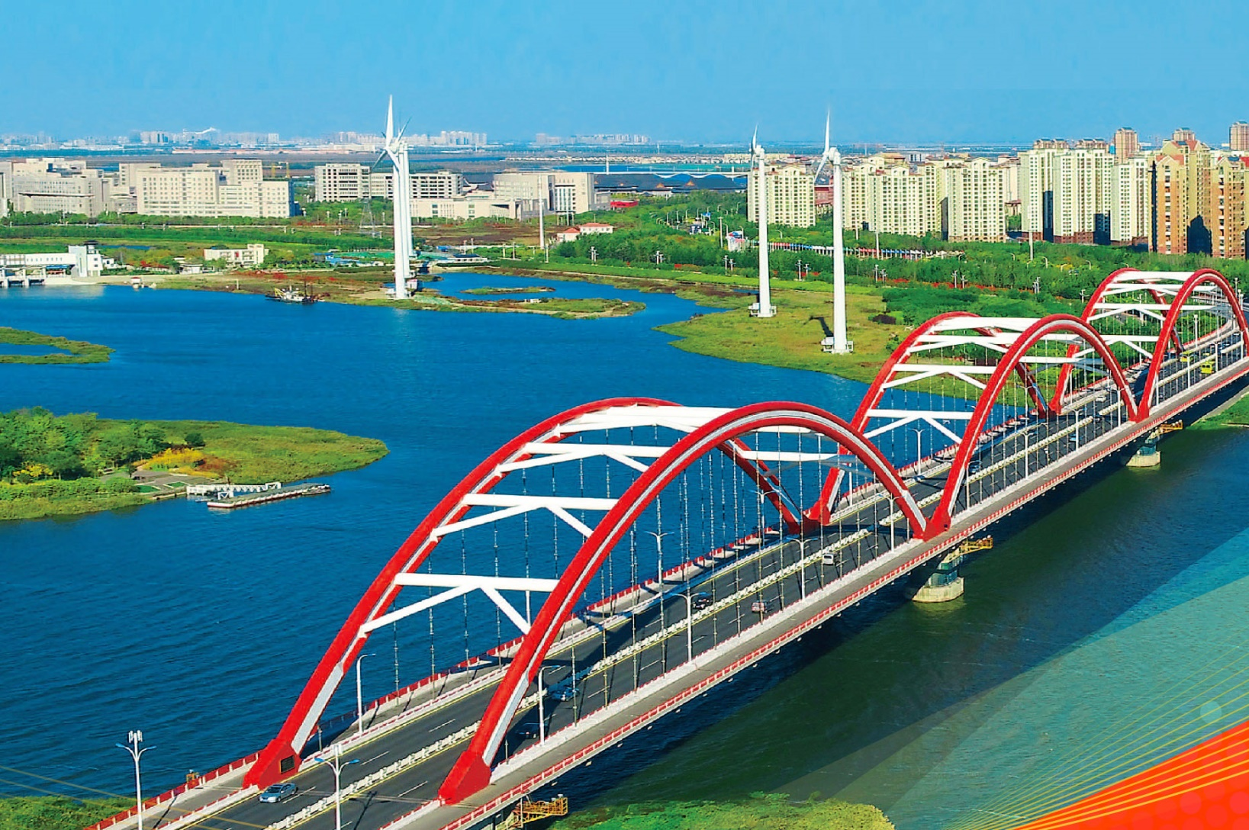
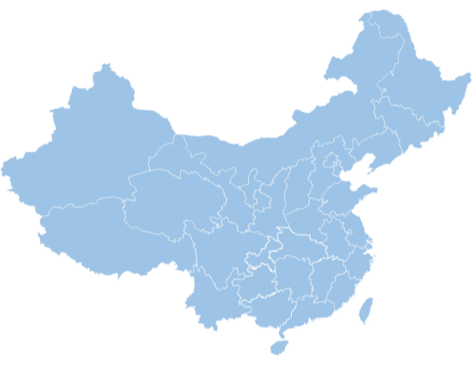
China-Singapore Tianjin Eco-city
150 km², Locates in Eastern coast salted land of Tianjin City
13 km², the buildup area with 100,000 population
The only National Green Development Demonstrative Area of China State Council.

Slide 39

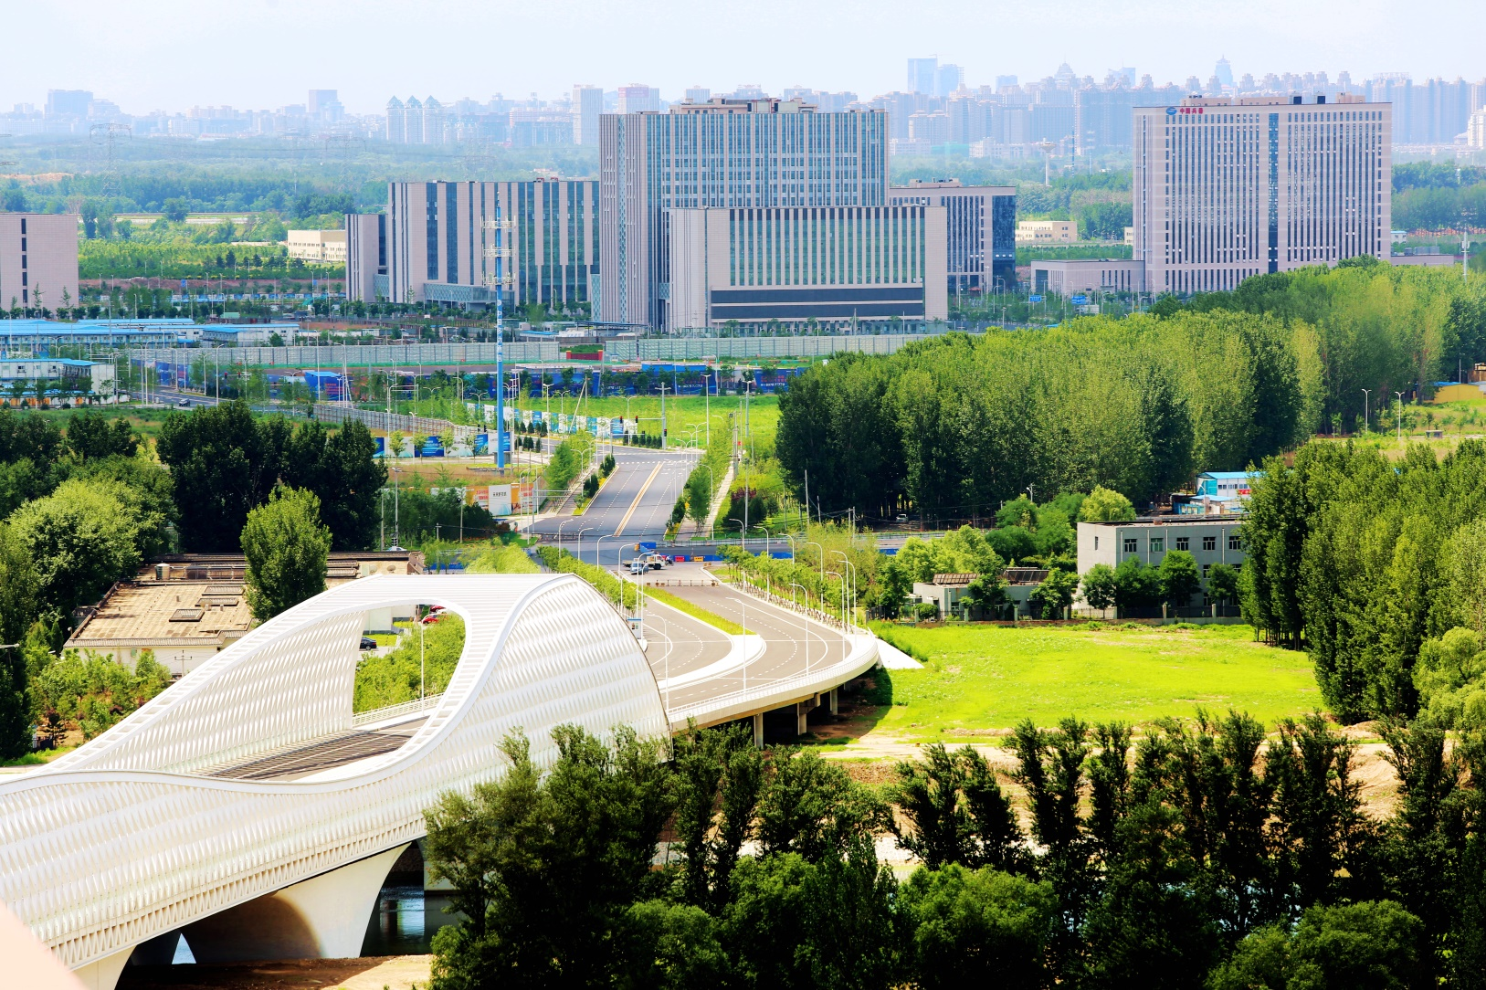
Beijing future science park
10km²， in the northeastern satellite science business district of Beijing
100,000 population;
One of the three major scientific cities of China State Council.

Slide 40

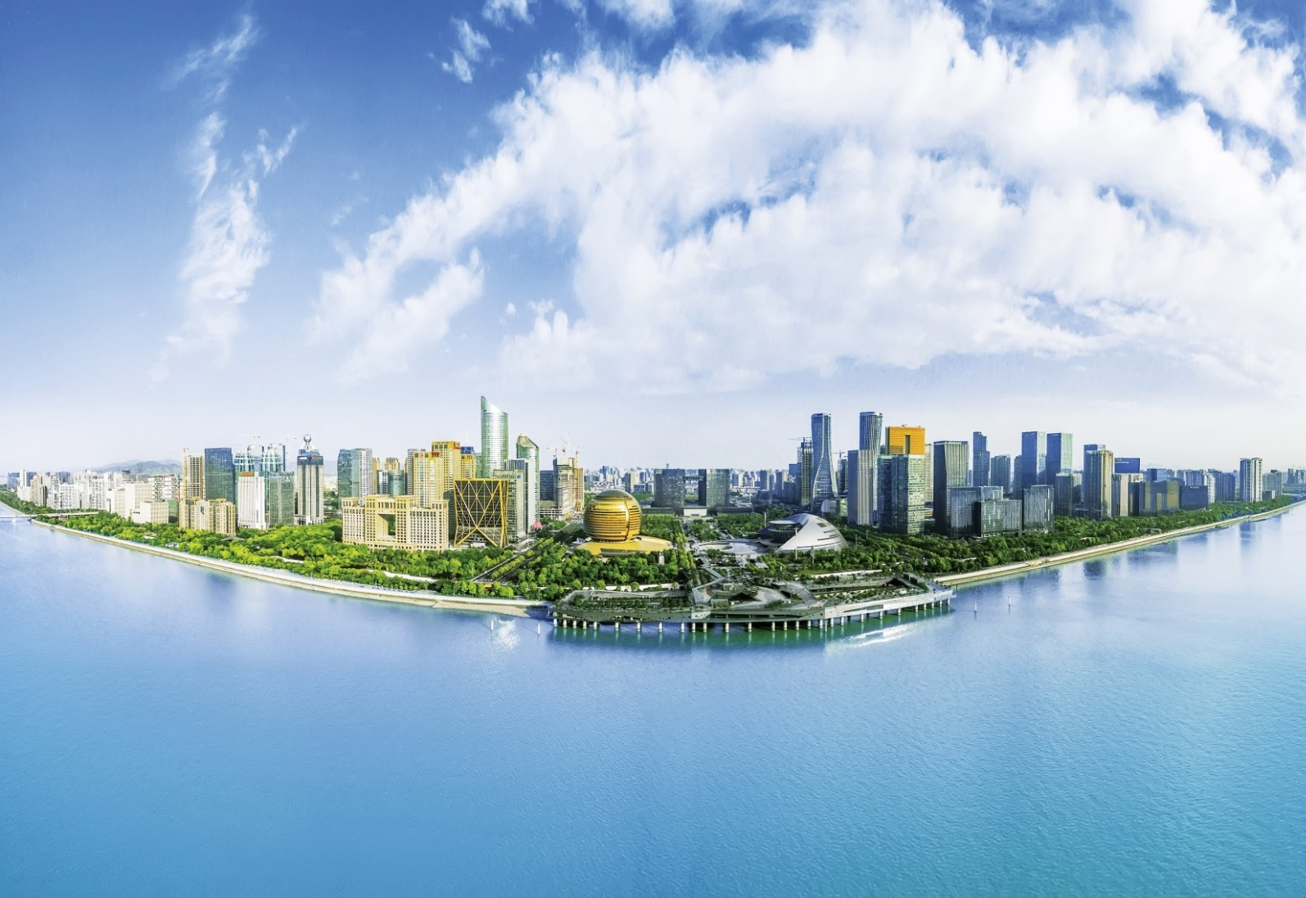
Hangzhou CBD
4 km²，located in Jiang gan district of the eastern part of Hangzhou City；
70,000 population;
The political, economic , cultural and communication hubs of Hangzhou, China.

Slide 41
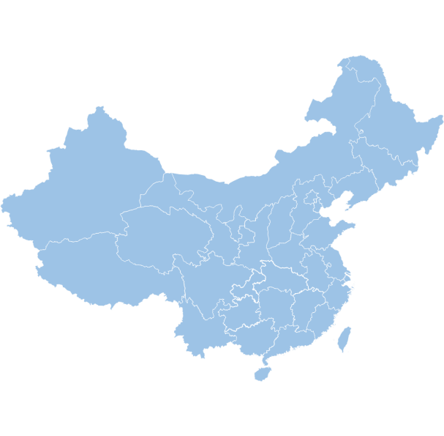
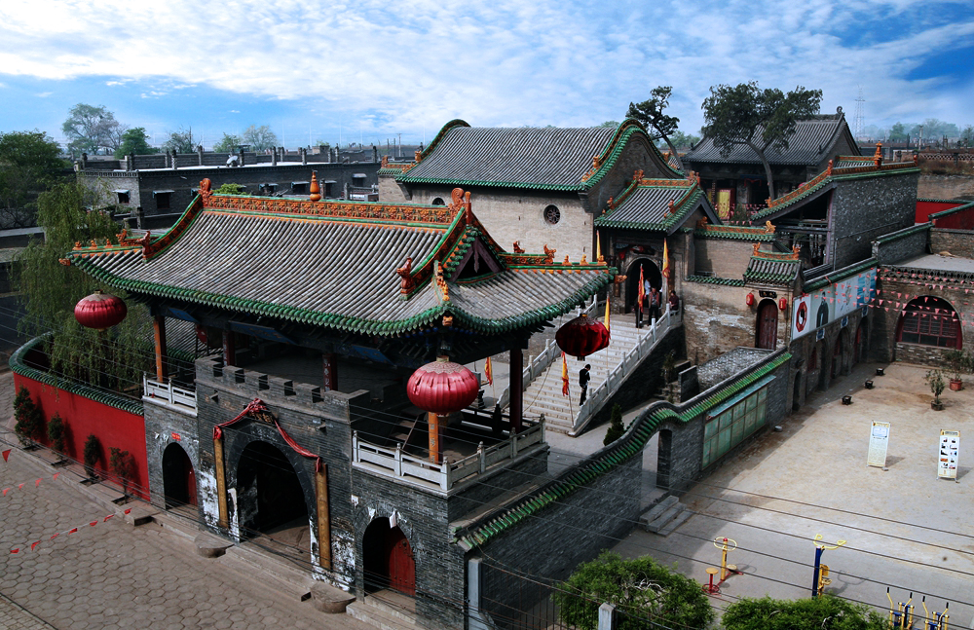
Xiaoyi
Xiaoyi city
located in the central part of Shanxi, under the Lvliang Mountain, on the bank of Surabaya,
500,000 population；
It is located in the Taiyuan economic circle node

Slide 42
Closing remarks
International Smart Sustainable City Club

