Slide 1


2018
ISSCC
Opening ceremony
International Smart Sustainable City Club
Moscow, 16th October 2018

Slide 2
CONTENT
目 录
01
Introduction
02
Progress
04
03
New Members 2018

Slide 3
01
Background
PART ONE

Slide 4
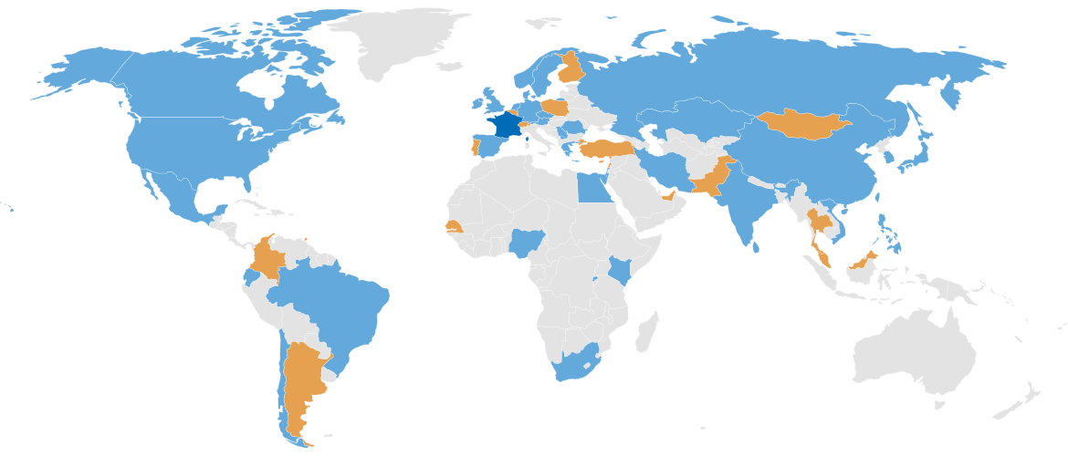
ISO TC 268 Sustainable cities and communities
The proposed series of International Standards will encourage the development and implementation of holistic and integrated approaches to sustainable development & sustainability.
Participating countries: 37
Observing countries: 21
Secretariat: AFNOR, Mr. Etienne Cailleau
Chairman: Dr. Bernard Gindroz
Creation date: 2012

Slide 5
ISO TC 268 Sustainable cities and communities
A need to get feedbacks from practical implementation
→ International Smart Sustainable City CLUB (ISSCC)
Political Commitment
experiment/demo/pilot
Vision
1. DECISION/
COMMIT
(Strategy)
2. PLAN
(roadmap & targets)
3. DO
Implementation)
4. CHECK
(against targets)
5. ACT
(Correct)
Management throughout the whole process

Slide 6
02
Progress
PART TWO

Slide 7
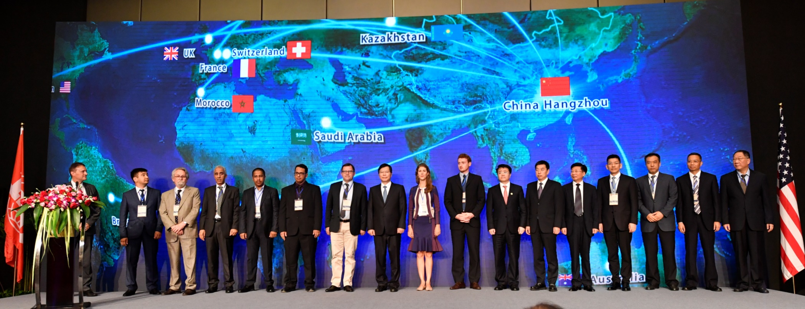
ISSCC officially launched on June 30th, 2017
16 cities globally participated, with support of ISO, IEC, ITU-T, UN, World Bank.
Rennes, France;
Versailles Grand Parc, Paris Region, France;
Grasmere, United Kingdom;
Astana, Kazakhstan;
Londrina, Brazil;
Riyadh, Saudi Arabia;
Abu Dhabi, United Arab Emirates;
Rabat, Morocco;
China:
Hangzhou; Guangzhou; Shenzhen; Qingdao;
Chengdu; Dalian; Changchun; Xianning

Slide 8
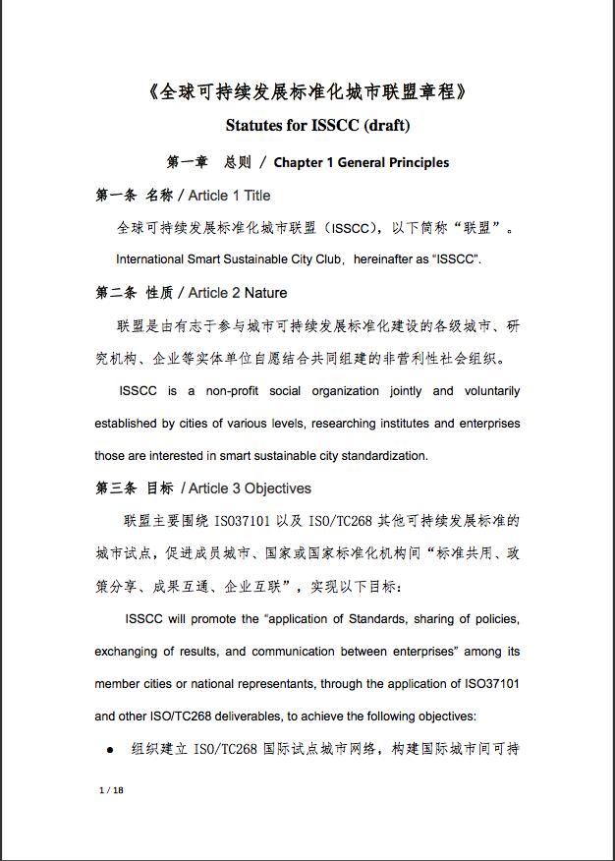
ISSCC progress
ISSCC is a non-profit organization jointly and voluntarily established by cities of various levels, researching institutes and enterprises those are interested in smart sustainable city standardization.
The ISSCC Statutes include the objectives, main tasks, organizational structure, access procedures and operation mode.
Two preparation workshops were held by the Technical Decision-Making Committee.
The third TDM meeting will be held in Moscow, 18th October, 2018.
Statutes for ISSCC (draft)
《全球可持续发展标准化城市联盟章程》

Slide 9
ISSCC Objectives
ISSCC will promote the “application of Standards, sharing of policies, exchanging of results, and communication between enterprises” among its member cities or national representants, through the application of ISO37101 and other ISO/TC268 deliverables, to achieve the following objectives:
To organize a Pilot Global City Network for ISO/TC268, to build platform for exchange among cities on sustainable urban development, to improve the sustainability within cities and efficiency of governance for member cities, and to promote cooperation among cities.
To organise the active participation of pilot cities in workshops in conjunction with ISO/TC 268 meetings, to come up with feedbacks and suggestions of urban sustainable development, and to propose recommendations for ISO standards.
To promote international cooperation among member cities and to organise and deepen collaborations among cities, through standard implementation, guidance, exchange and communication. And to contribute to economic collaborations.
1
2
3

Slide 10
03
New members 2018
PART THREE

Slide 11

New members 2018
Krasnodar
CSEC Tianjin
Novorossiysk
Beijing FSP
Sochi
ISSCC
Hangzhou CBD
Togliatti
Xiaoyi
Voronezh
Innopolis
Sarov
Magas

Slide 12
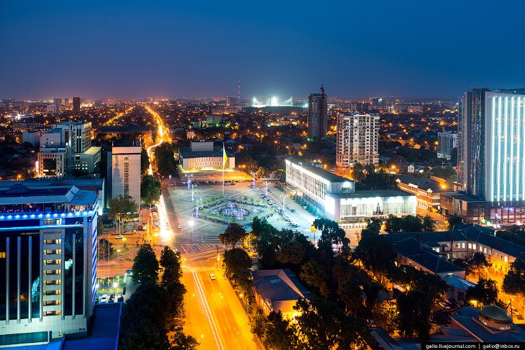

Krasnodar
Moscow
Krasnodar
The administrative center of Krasnodar Krai, Russia
Krasnodar is the economic center of southern Russia
For several years, Forbes magazine named Krasnodar the best city for business in Russia
1,000,000 population
Area 339 sq. km

Slide 13
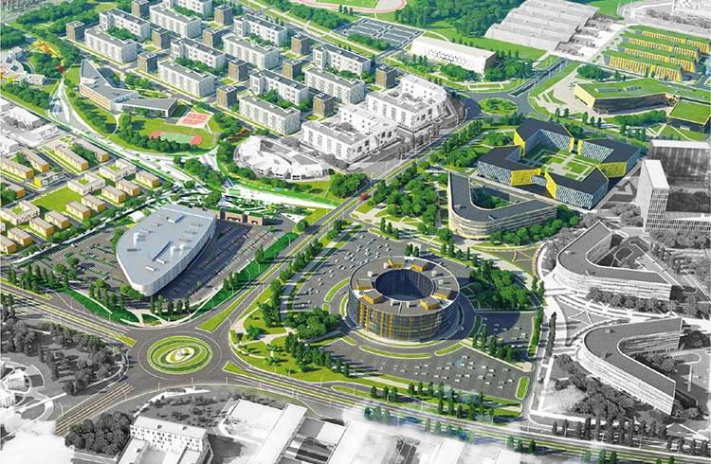
Innopolis
Moscow
Innopolis
Innopolis is a town in Verkhneuslonsky District of the Republic of Tatarstan, Russia
Innopolis was established on December 24, 2012 as a technology park
Innopolis has created a Special economic zone to attract promising technology companies
102 population
Area 2,2 sq. km

Slide 14
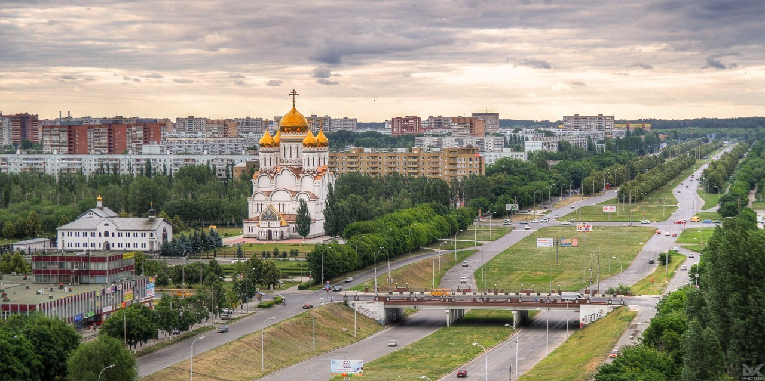

Togliatti
Moscow
Togliatti
Togliatti is a city in Samara Oblast, Russia
Togliatti is best known as the home of Russia's largest car manufacturer AvtoVAZ (Lada), which was founded in the late 1960s
710,567 population
Area 314 sq. km

Slide 15
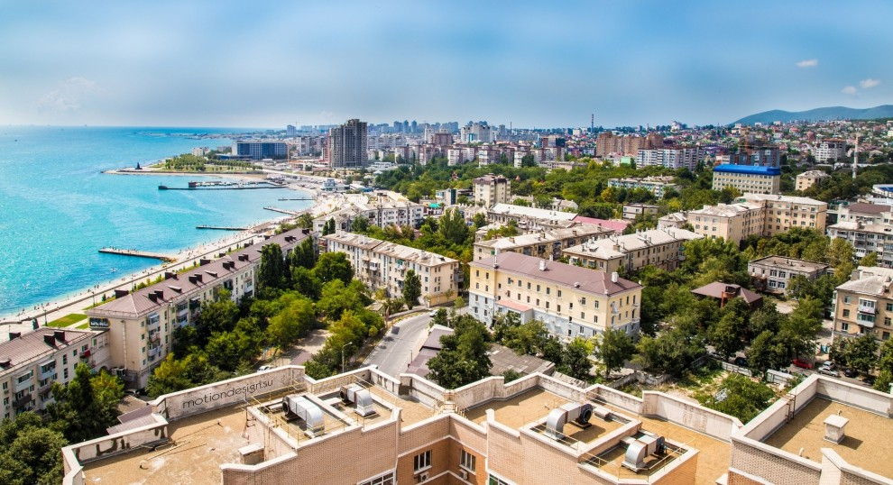

Novorossiysk
Moscow
Novorossiysk
Novorossiysk is a city in Krasnodar Krai, Russia
It is the country's main port on the Black Sea, the leading Russian port for exporting grain, the center of the cement industry
273,278 population
Area 81 sq. km

Slide 16
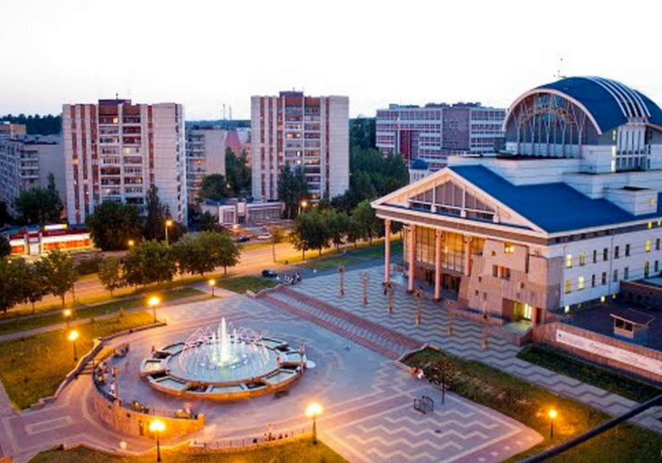

Sarov
Moscow
Sarov
Sarov is a closed city in Russia, located on the territory of the Nizhny Novgorod region and the Republic of Mordovia
The city-forming enterprise of Sarov is Russian Federal Nuclear Center - Russian Research Institute of Experimental Physics
95,065 population
Area 232 sq. km

Slide 17
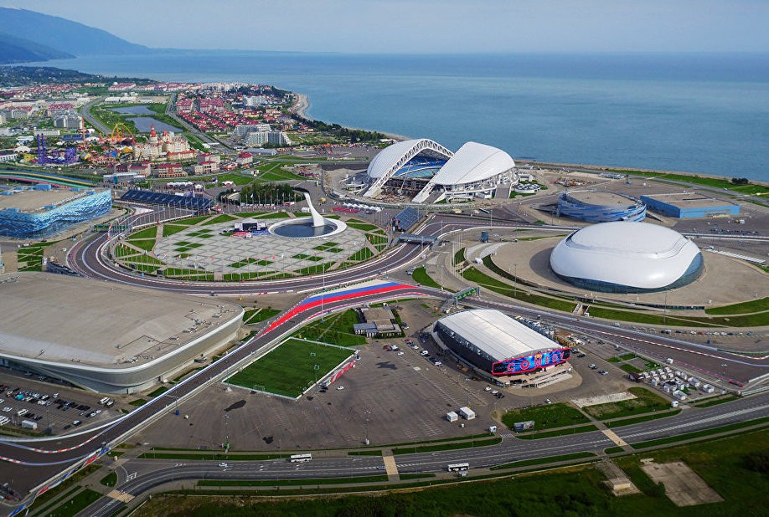

Sochi
Moscow
Sochi
Sochi is a city in Krasnodar Krai, Russia
Sochi is the largest resort city in Russia
Sochi hosted the XXII Olympic Winter Games in 2014, Russian Formula 1 Grand Prix from 2014, was one of the host cities for the 2018 FIFA World Cup
424,281 population
Area 177 sq. km

Slide 18
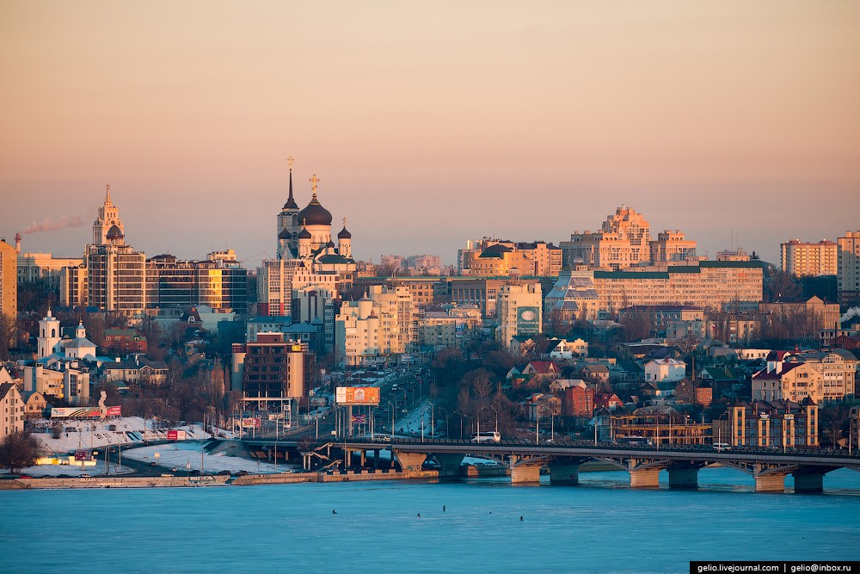

Voronezh
Moscow
Voronezh
Voronezh is a city and the administrative center of Voronezh Oblast, Russia
Voronezh is considered to be the birthplace of the Russian state navy and of airborne troops
1,058,547 population
Area 600 sq. km

Slide 19

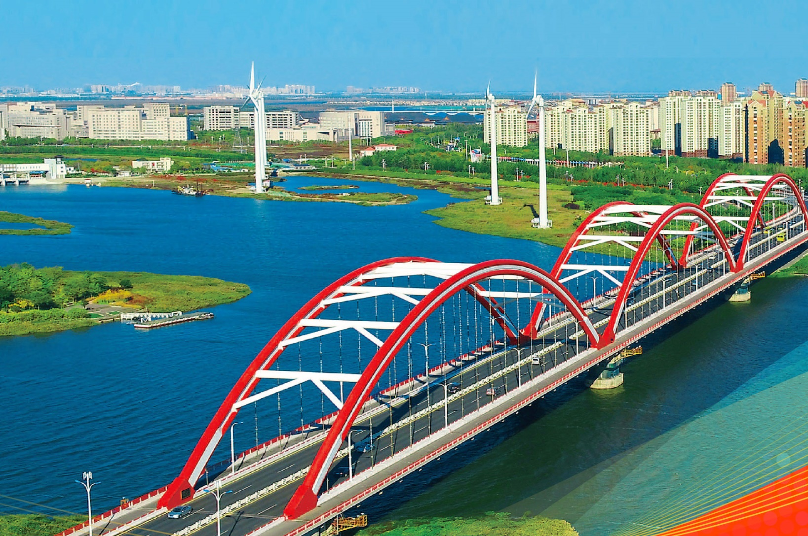
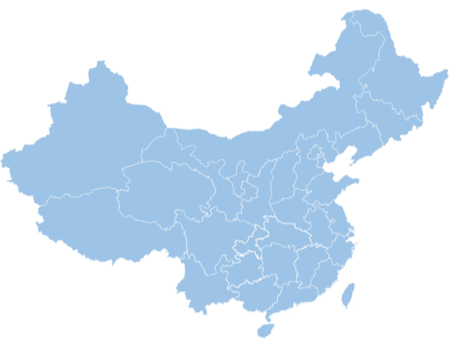
China-Singapore Tianjin Eco-city
The only National Green Development Demonstrative Area of China State Council.
Area 150 km², Locates in Eastern coast salted land of Tianjin City
The current buildup area 13 km², with 100,000 population.

Slide 20

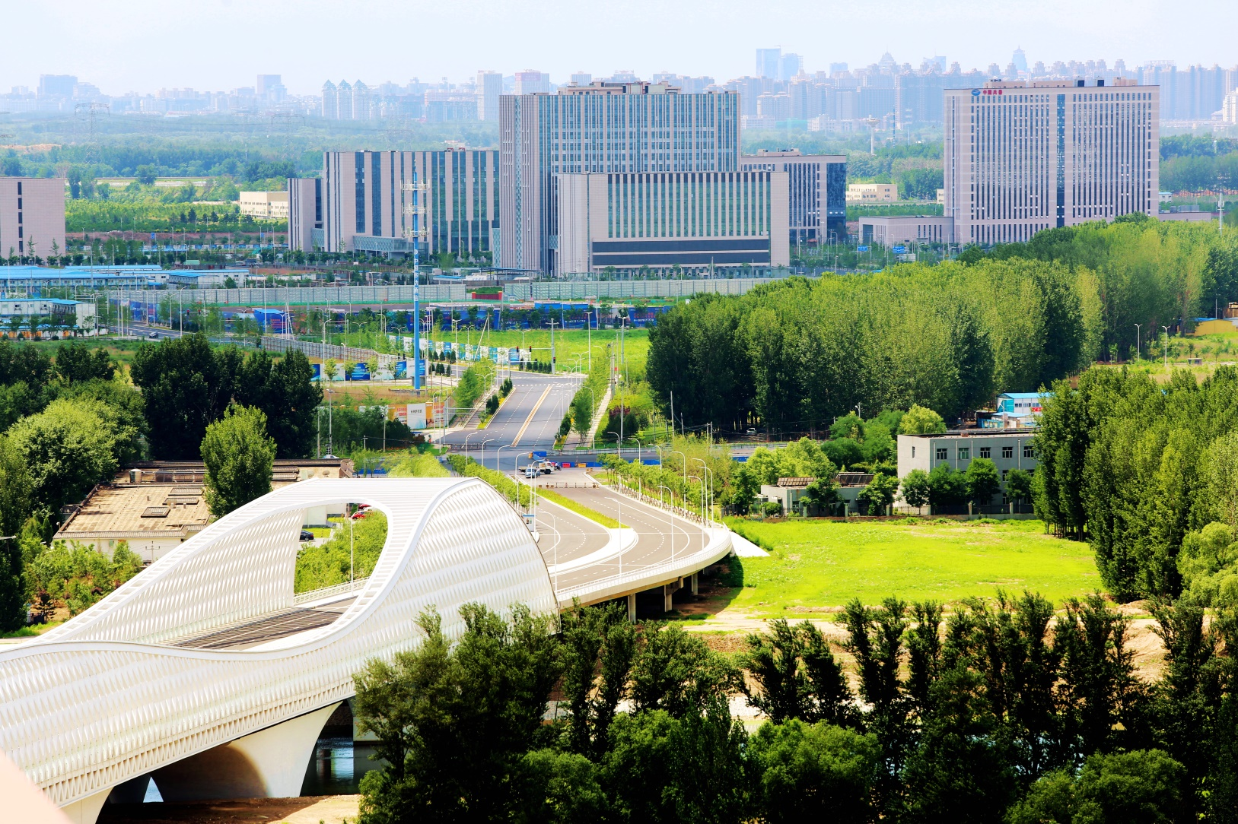
Beijing future science park
One of the three major scientific cities of China State Council.
Area 10km²，in the northeastern satellite science business district of Beijing
100,000 population;

Slide 21
Closing remarks
International Smart Sustainable City Club

