Slide 1



2018
ISSCC
International Smart Sustainable City Club
18th October 2018

Slide 2
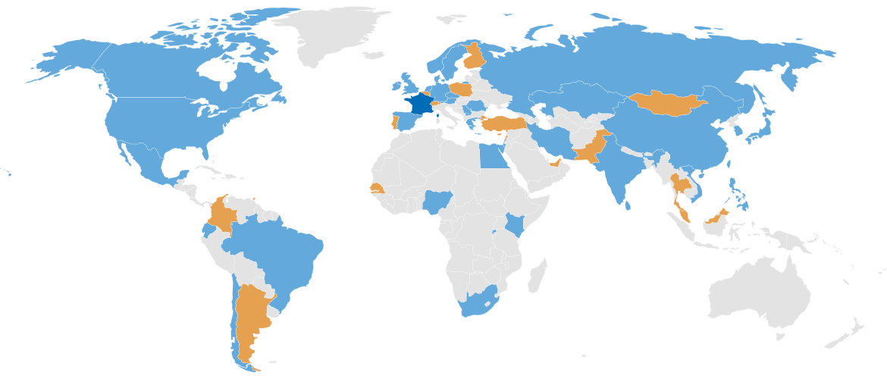
ISSCC Context
ISO TC 268 Sustainable cities and communities
The proposed series of International Standards will encourage the development and implementation of holistic and integrated approaches to sustainable development & sustainability.
Participating countries: 37
Observing countries: 21
Secretariat: AFNOR, Mr. Etienne Cailleau
Chairman: Dr. Bernard Gindroz
Creation date: 2012

Slide 3

ISO TC 268 Sustainable cities and communities
Identify infrastructures issues
Identify mutlisectorial issues
Set Indicators for progress follow-up and reporting
…to help implementing the roadmaps/actions plans
Terms and Definitions
Description of cities
Strategies for long term vision
…to help decision/commitment
Multi sectorial Strategies for cities
Targets with Indicators
…to help setting roadmaps with targets
Measure progress towards planned targets
… to evaluate the results of the actions
Vision
2. PLAN
(roadmap & targets)
3. DO
Implementation)
4. CHECK
(against targets)
5. ACT
(Correct)
1. DECISION/
COMMIT
(Strategy)
Diagnostic of city’s « readiness level » (maturity)
…for setting a long term vision
Management & governance,
and guidelines

Slide 4



ISO TC 268 Sustainable cities and communities
ISO 3715x
ISO 37106
ISO 3712x
Identify infrastructures issues
Identify mutlisectorial issues
Set Indicators for progress follow-up and reporting
…to help implementing the roadmaps/actions plans
Multi sectorial Strategies for cities
Targets with Indicators
…to help setting roadmaps with targets
ISO 37100
ISO 37105
ISO 37106
ISO 37106
ISO 3712x
Terms and Definitions
Description of cities
Strategies for long term vision
…to help decision/commitment
ISO 3712x
Measure progress towards planned targets
… to evaluate the results of the actions
Vision
2. PLAN
(roadmap & targets)
3. DO
Implementation)
4. CHECK
(against targets)
5. ACT
(Correct)
1. DECISION/
COMMIT
(Strategy)
ISO 18091
Diagnostic of city’s « readiness level » (maturity)
…for setting a long term vision
ISO 37101
ISO 37104 series
Management & governance,
and guidelines

Slide 5
ISSCC Context
A need to get feedbacks from practical implementation
→ International Smart Sustainable City CLUB (ISSCC)
Political Commitment
Implementation/demo/pilot
Vision
1. DECISION/
COMMIT
(Strategy)
2. PLAN
(roadmap & targets)
3. DO
Implementation)
4. CHECK
(against targets)
5. ACT
(Correct)
Management throughout the whole process

Slide 6
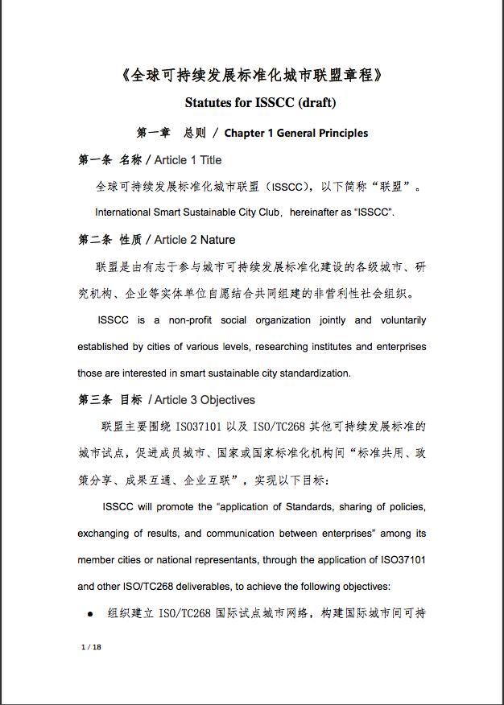
ISSCC CONTEXT
ISSCC is a non-profit organization jointly and voluntarily established by cities of various levels, researching institutes, enterprises and NGOs interested in smart sustainable city standardization.
The ISSCC Statutes include the objectives, main tasks, organizational structure, access procedures and operation mode.
Statutes for ISSCC (draft)

Slide 7
ISSCC Objectives
ISSCC will promote the principle of “applying standards, sharing policies, exchanging results, and communication between enterprises” among its members, through the application of ISO37101 and other ISO/TC268 deliverables, to achieve the following objectives:
Organize a Global City Network piloting ISO/TC268 standards, build an exchanging platform for cities on sustainable development, and improve sustainability and efficiency of governance for member cities.
Actively participate ISSCC events in conjunction with ISO/TC 268 meetings, collect feedbacks and suggestions on urban sustainable development, and offer recommendations for ISO TC 268 standards.
Promote international cooperation among member cities, through standard implementation, exchanging and communication. Also contribute to economic collaborations between cities.
1
2
3

Slide 8

ISSCC Main tasks
ISSCC will actively involve worldwide cities of various levels and national representatives, with the main tasks as below:
Hosting congress and seminars, establishing liaisons among mayors;
Constructing a communication platform;
Helping members to become international smart sustainable pilots of ISO 37101 and then ISO 371XX series;
Support cities for auto-evaluation of progresses;
During the implementation of ISO/TC268 standards (especially ISO37101), provide support and guidance through different stages:

Slide 9
ISSCC Organizational chart
Permanent
Chair City
Chairperson
of ISSCC
Executive Chairperson
Duty Chair City
Congress of ISSCC
Council of ISSCC
President of ISO/TC268;
Rep. of SAC;
Rep. of AFNOR;
Rep. of add. NSB;
Rep. of Permanent Chair City;
Rep. of council
Technical Decision-Making committee
Guide
Secretariat
(Organised by Secretariat of ISO/TC268)
Supervise
liaise
Think Tank
NSB of member cities
Guide & Support
P Member cities
S Members
Expert Committee
Advisory Institutes
Support and Quality Control

Slide 10
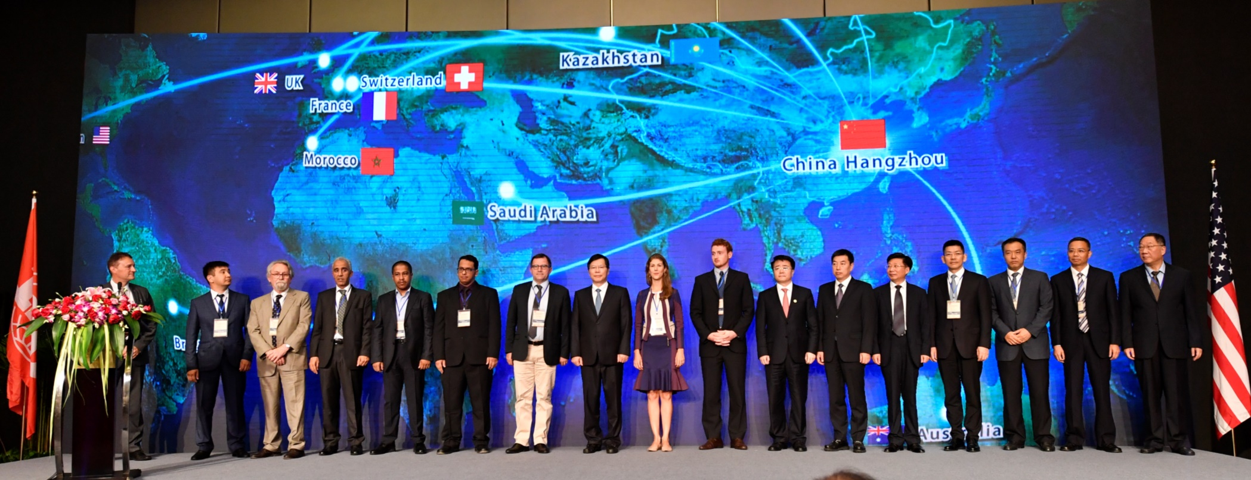
ISSCC officially launched on June 30th, 2017
16 cities globally participated, with support of ISO, IEC, ITU-T, UN, World Bank.
Rennes, France;
Versailles Grand Parc, Paris Region, France;
Grasmere, United Kingdom;
Astana, Kazakhstan;
Londrina, Brazil;
Riyadh, Saudi Arabia;
Abu Dhabi, United Arab Emirates;
Rabat, Morocco;
China:
Hangzhou; Guangzhou; Shenzhen; Qingdao;
Chengdu; Dalian; Changchun; Xianning

Slide 11

New members 2018
Krasnodar
CSEC Tianjin
Novorossiysk
Beijing FSP
Sochi
ISSCC
Hangzhou CBD
Togliatti
Xiaoyi
Voronezh
Innopolis
Sarov
Magas

Slide 12
Resolution of
TDM 1st Preparation Meeting Beijing, Jan. 2018
Acceptance procedure for new member entering with experimentation, information collection and feedback.
three points included:
  Small and medium-sized cities topic
  Provide infrastructure and services for the aging group
  the Beijing – Hangzhou Grand Canal concept
Dr. Bernard GINDROZ is the Chairperson, and Ms. SHAO Xinhua was authorized as the first Secretary General of ISSCC with a term of 5 years.
Held the 2nd club conference in 2018, time and place to be decided.

Slide 13
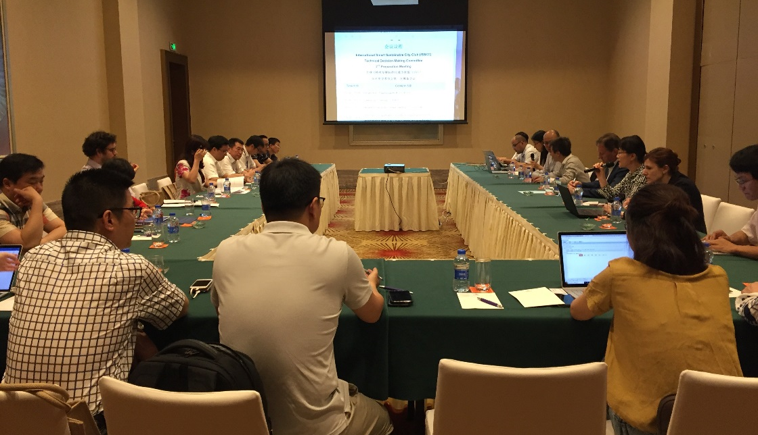
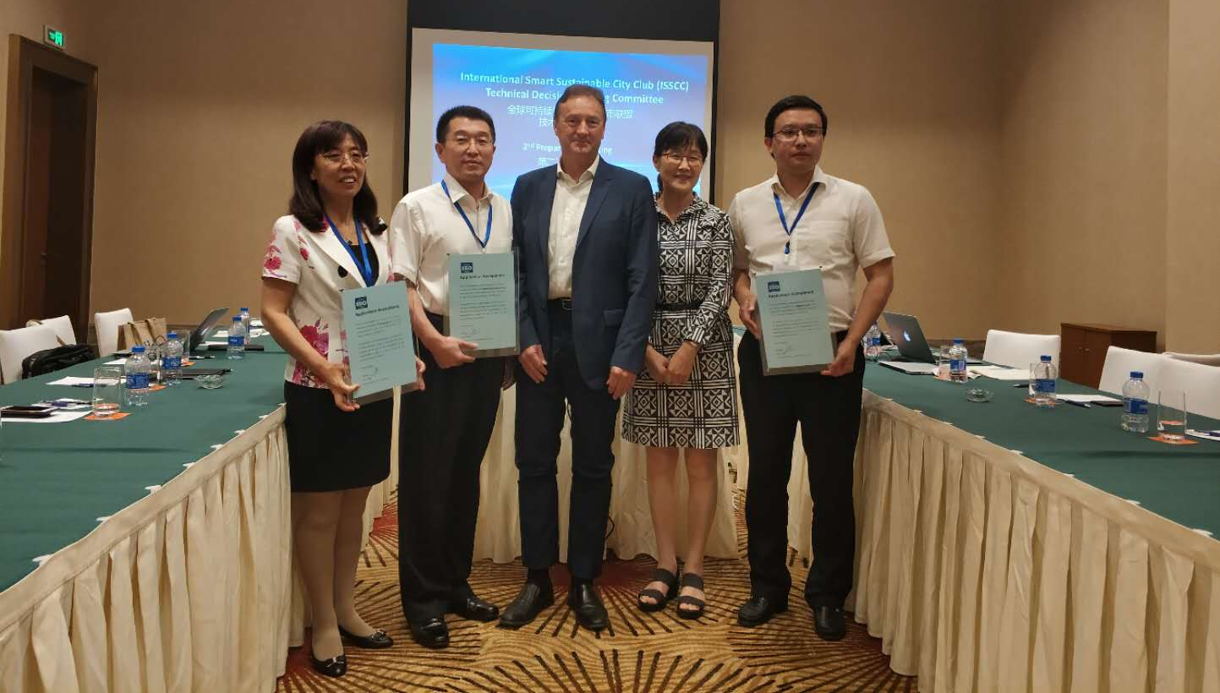
Resolution of
TDM 2nd Preparation Meeting Zhuhai, May 2018
Procedure approved on Experimentation stage, Demonstration Stage, and Pilot Stage.
Application Acceptance letters issued to BFSP, Hangzhou CBD and Xiaoyi City to become experimentation city on ISO 37101.
Next meeting agreed in Moscow, October 15-19，2018.

Slide 14
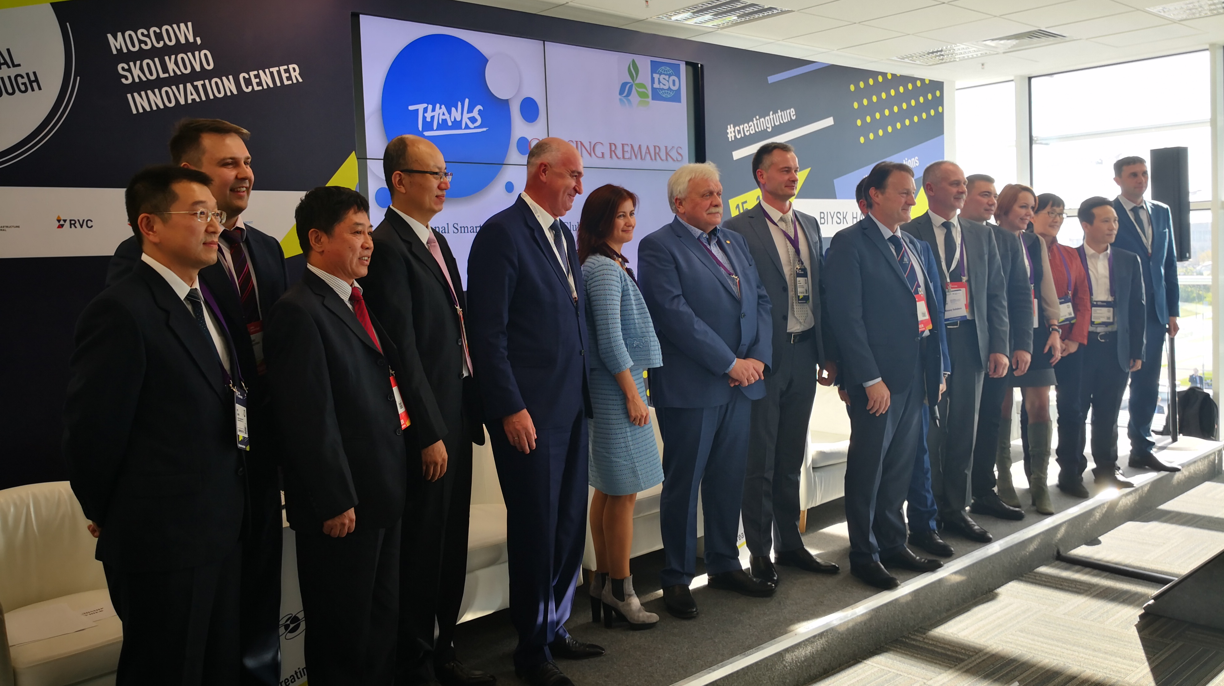
Opening Ceremony &
TDM 3rd Preparation Meeting Moscow, October 2018

Slide 15
International Smart Sustainable City Club

Slide 16
ISSCC Organizational chart
Permanent
Chair City
Chairperson
of ISSCC
Executive Chairperson
Duty Chair City
Congress of ISSCC
Council of ISSCC
President of ISO/TC268;
Rep. of SAC;
Rep. of AFNOR;
Rep. of add. NSB;
Rep. of Permanent Chair City;
Rep. of council
Technical Decision-Making committee
Guide
Secretariat
(Organised by Secretariat of ISO/TC268)
Supervise
liaise
Think Tank
NSB of member cities
Guide & Support
P Member cities
S Members
Expert Committee
Advisory Institutes
Support and Quality Control

